Slide 1


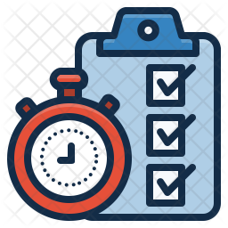
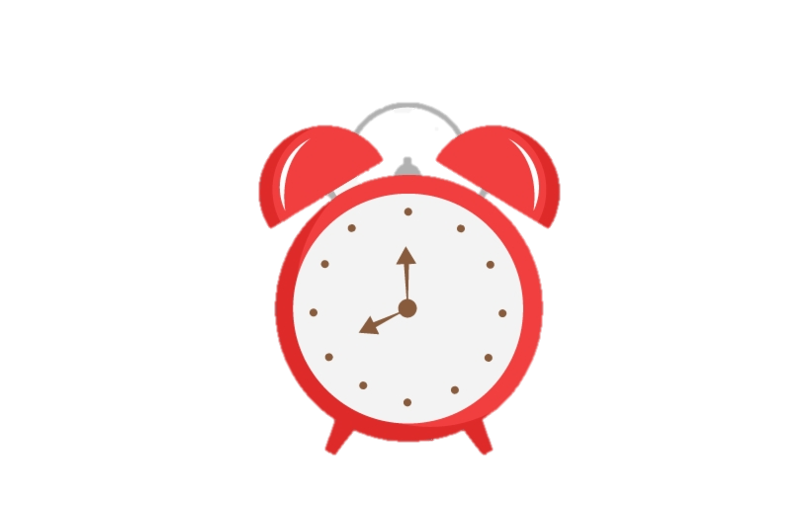





Setting Up My Workspace
Click on the correct items you’ll need to set up your remote office below
A desk clock would help you maximize and keep track of time!
1.
2.
A checklist of the day’s activity will keep you focused and committed
3.
4.
Keep a clean desk like you would in the office
You may not need a briefcase since you are at home!
Checking your emails would keep you connected to your team and customers
5.
6.
A cup of coffee will keep you active and lively!

